Slide 1

CALORIE BURNT PREDICTION SYSTEM
.

Slide 2

Sreenidhi institute of science and technology
Department of computer science & engineering
Implementation ppt
on
Calorie Burnt Prediction System
By
Dondula yashasvini 21311A05D2
Devireddy Nandini 21311A05H9
Mohammed Azam 21311A05G2
III - CSE - C - II Semester
Domain: Machine Learning
Academic Year: 2023-24
Under the supervision
Mr.Venkata Subba Reddy
Batch No: C15

Slide 3
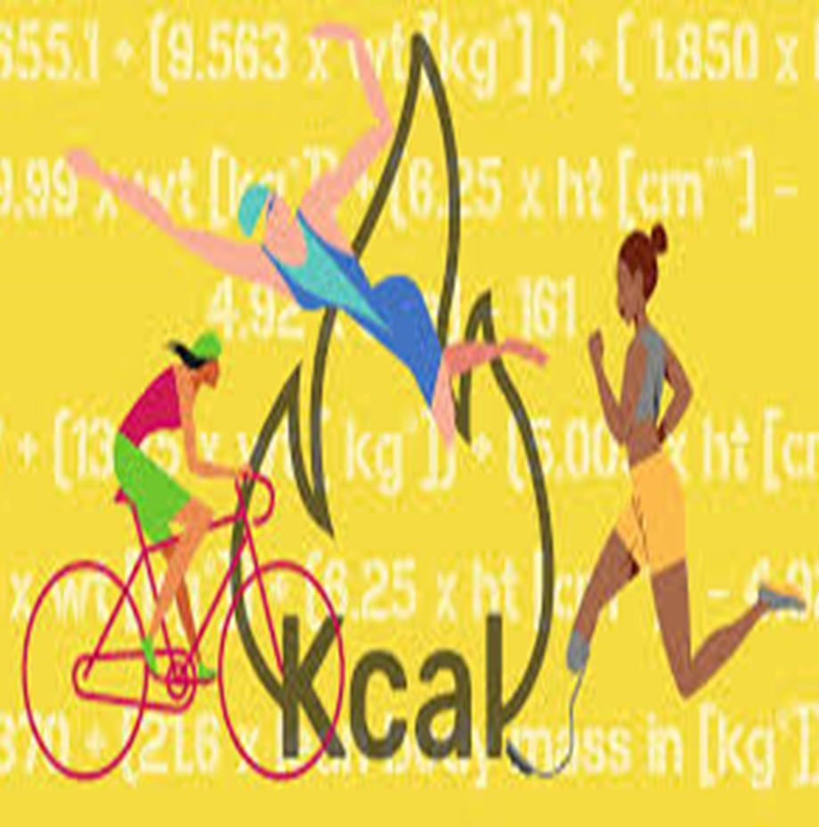


Contents
Abstract
Introduction
Hardware & software requirements
Existing system
Proposed system
Modules
Design flow
Results
Output
Future scope
Conclusion
References

Slide 4
Abstract
The Calories Burnt Prediction System (CBPS) employs advanced machine learning algorithms to accurately estimate calorie expenditure during various physical activities. Leveraging diverse datasets encompassing a wide range of activity types, durations, intensities, and individual biometric data, CBPS utilizes sophisticated feature engineering techniques to extract relevant information for precise predictions. Real-time monitoring capabilities empower users to dynamically track their calorie expenditure, facilitating informed decision-making in pursuit of fitness goals and overall well-being. By incorporating heterogeneous datasets and employing feature selection techniques, CBPS establishes intricate associations between input parameters and caloric expenditure, enhancing prediction accuracy. With instantaneous feedback on calorie burn rates, users are motivated to engage more actively in fitness activities. Methodologies such as cross-validation and comparison with actual data validate the robustness and reliability of CBPS. In a study comparing machine learning models, XGBoost emerged as the superior choice for predicting calorie burn based on a dataset comprising 15,000 records with seven features, including heart rate, body temperature, and activity duration, achieving an accuracy of 89.5%.Overall, CBPS serves as a valuable tool for individuals, fitness enthusiasts, and healthcare professionals alike, facilitating informed decision-making and fostering a proactive approach to physical fitness and well-being.

Slide 5
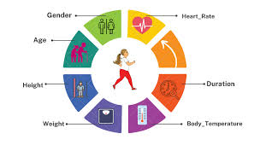

Introduction
The amount of calories burnt depends on internal and external factors, it is subjective and different for everyone depending on their height, weight, and fitness level [1]. Generally, people relate calories to weight or food reduction however it is a quantity of heat energy. From a human perspective, the number of calories is the amount of energy required to carry out a task. Different items have different calorie values related to them.As a human body performs some extensive activity or workout the body temperature and heart rate start rising which leads to the production of heat energy in the body. Which ultimately causes calories to burn. To show the same we take some input parameters such as age, gender, height, and weight and apply different regression algorithms such as linear regression, XG Boost regression, AdaBoost regression, SVR, Decision tree regression, and Random forest regression over the data to get the best and optimal results.

Slide 6
Software & Hardware Requirements
Software
Hardware
1. Python Programming Language Environment
2. XGBoost Library
3. Pandas for Data Manipulation
4. NumPy for Numerical Operations
6. Matplotlib or Seaborn for Visualization
7. Jupyter Notebook or JupyterLab for Interactive Development
8. Integrated Development Environment (IDE)
9. Version Control System (Optional)
10. Environment Management Tool (Optional)
1. Processor (CPU)
2. Memory (RAM)
3. Storage
4. Graphics Processing Unit (GPU) (optional)
5. Operating System
6. Internet Connection
7. Miscellaneous

Slide 7
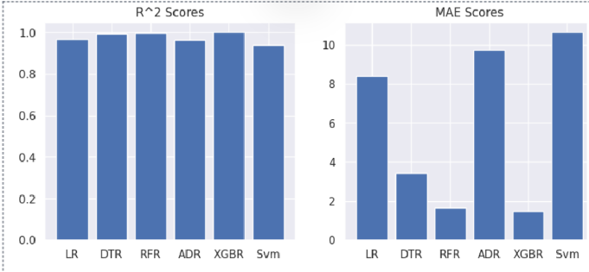
Existing system
Regresssions | Mean absolute error
Linear regression | 8.3851
Decision tree regression | 3.343
Random forest regression | 1.675
Ada boost regression | 8.670
SVR | 10.620

Slide 8
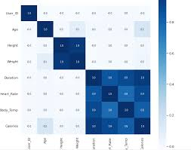
Proposed system
Objective: Integrate XGBoost regressor into the Calories Burnt Prediction System (CBPS) for precise calorie expenditure estimation during physical activities.
Steps:
Data Collection & Preprocessing
Feature Engineering
XGBoost Model Training
Real-Time Monitoring
Validation & Deployment
Benefits:
Empowers informed decision-making in fitness goals
Enhances user engagement and motivation
Facilitates proactive approach to well-being

Slide 9
Modules
import numpy as np
import pandas as pd
import matplotlib.pyplot as plt
import seaborn as sns
from sklearn.model_selection import train_test_split
from xgboost import XGBRegressor
from sklearn import metrics

Slide 10
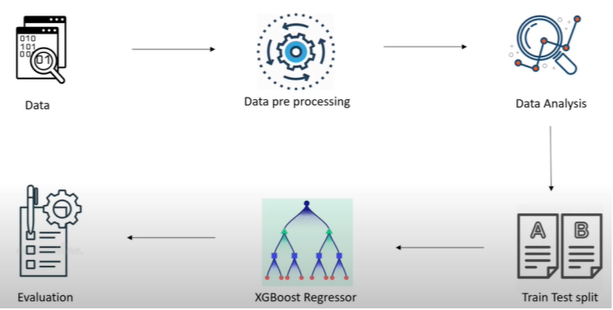

Slide 11
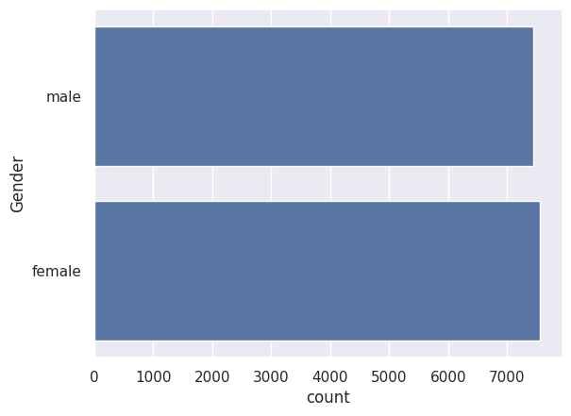
Results

Slide 12
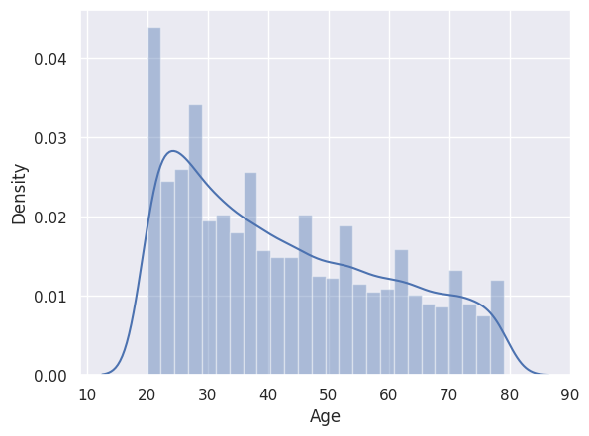

Slide 13
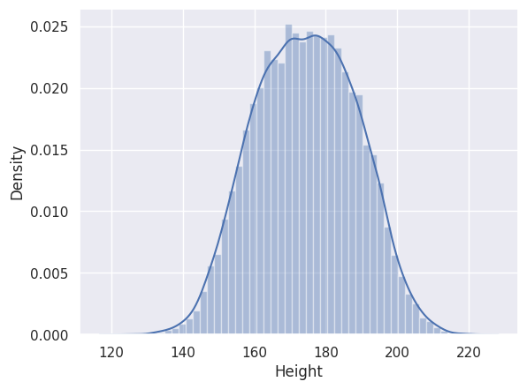

Slide 14
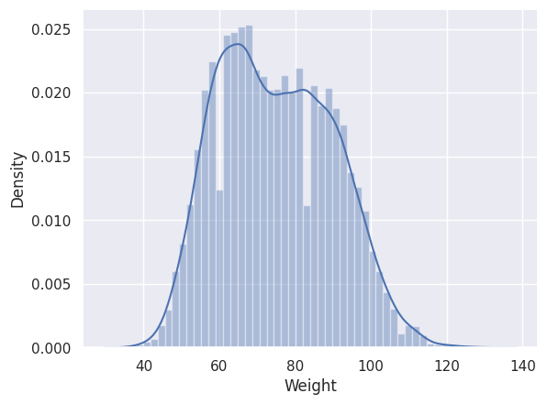

Slide 15
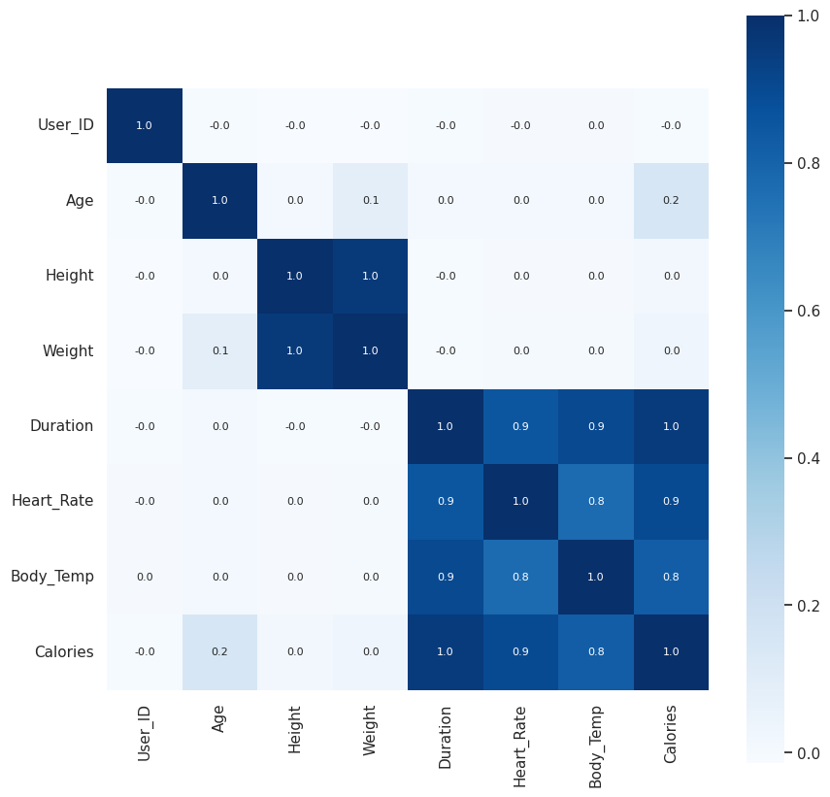

Slide 16
Future scope
Enhanced Accuracy and Personalization Improved Feature Engineering
Scalability and Real-time Processing Real-time Analytics
Interdisciplinary Integration Healthcare Application
Advanced Model Techniques Hybrid Models
User Engagement and Gamification Personalized Recommendations
Integration with IoT and Smart Environments Smart Homes and Gyms
Data Privacy and Security Enhanced Privacy
Research and Development Continuous Improvement:
Collaborative Research

Slide 17
Conclusion
The future scope of XGBoost in calorie burnt prediction systems is extensive and multi-faceted. By leveraging advanced data processing capabilities, integrating with cutting-edge technologies, and focusing on user-centric features, XGBoost can drive significant advancements in personalized fitness and health management solutions. Continuous innovation and interdisciplinary collaboration will further enhance its applicability and impact in this domain.

Slide 18
References
Goukens, Caroline, and Anne Kathrin Klesse. "Internal and external forces that prevent (vs. Facilitate) healthy eating: Review and outlook within consumer Psychology." Current Opinion in Psychology (2022): 101328.
Khan, Abdul Wahid, et al. "Factors Affecting Fitness Motivation: An Exploratory Mixed Method Study." IUP Journal of Marketing Management 21.2(2022).
Roberts, K. C., Shields, M., de Groh, M., Aziz, A., & Gilbert, J. A. (2012). Overweight and obesity in children and adolescents: results from the 2009 to 2011 Canadian Health Measures Survey. Health rep, 23(3), 37-41.
Kalpesh, Jadhav, et al. "Human Physical Activities Based Calorie Burn Calculator Using LSTM." Intelligent Cyber Physical Systems and Internet of Things: ICoICI 2022. Cham: Springer International Publishing, 2023. 405-424.
Tayade, Akshit Rajesh, and Hadi Safari Katesari. "A Statistical Analysis to Develop Machine Learning Models: Prediction of User Diet Type.“
Gour, Sanjay, et al. "A Machine Learning Approach for Heart Attack Prediction." Intelligent Sustainable Systems: Selected Papers of WorldS4 2021, Volume 1. Springer Singapore, 2022.
Panwar, Punita, et al. "A Prospective Approach on Covid-19 Forecasting Using LSTM." 2022 International Conference on Fourth Industrial Revolution Based Technology and Practices (ICFIRTP). IEEE, 2022.
Smola, Alex, and S. V. N. Vishwanathan. "Introduction to machine learning." Cambridge University, UK 32.34 (2008): 2008.
Nipas, Marte, et al. "Burned Calories Prediction using Supervised Machine Learning: Regression Algorithm." 2022 Second International Conference on Power, Control and Computing Technologies (ICPC2T). IEEE, 2022.
ITM Web of Conferences 54, 01010 (2023) https://doi.org/10.1051/itmconf/20235401010I3CS-2023

Slide 19
Thank You
.

